Slide 1
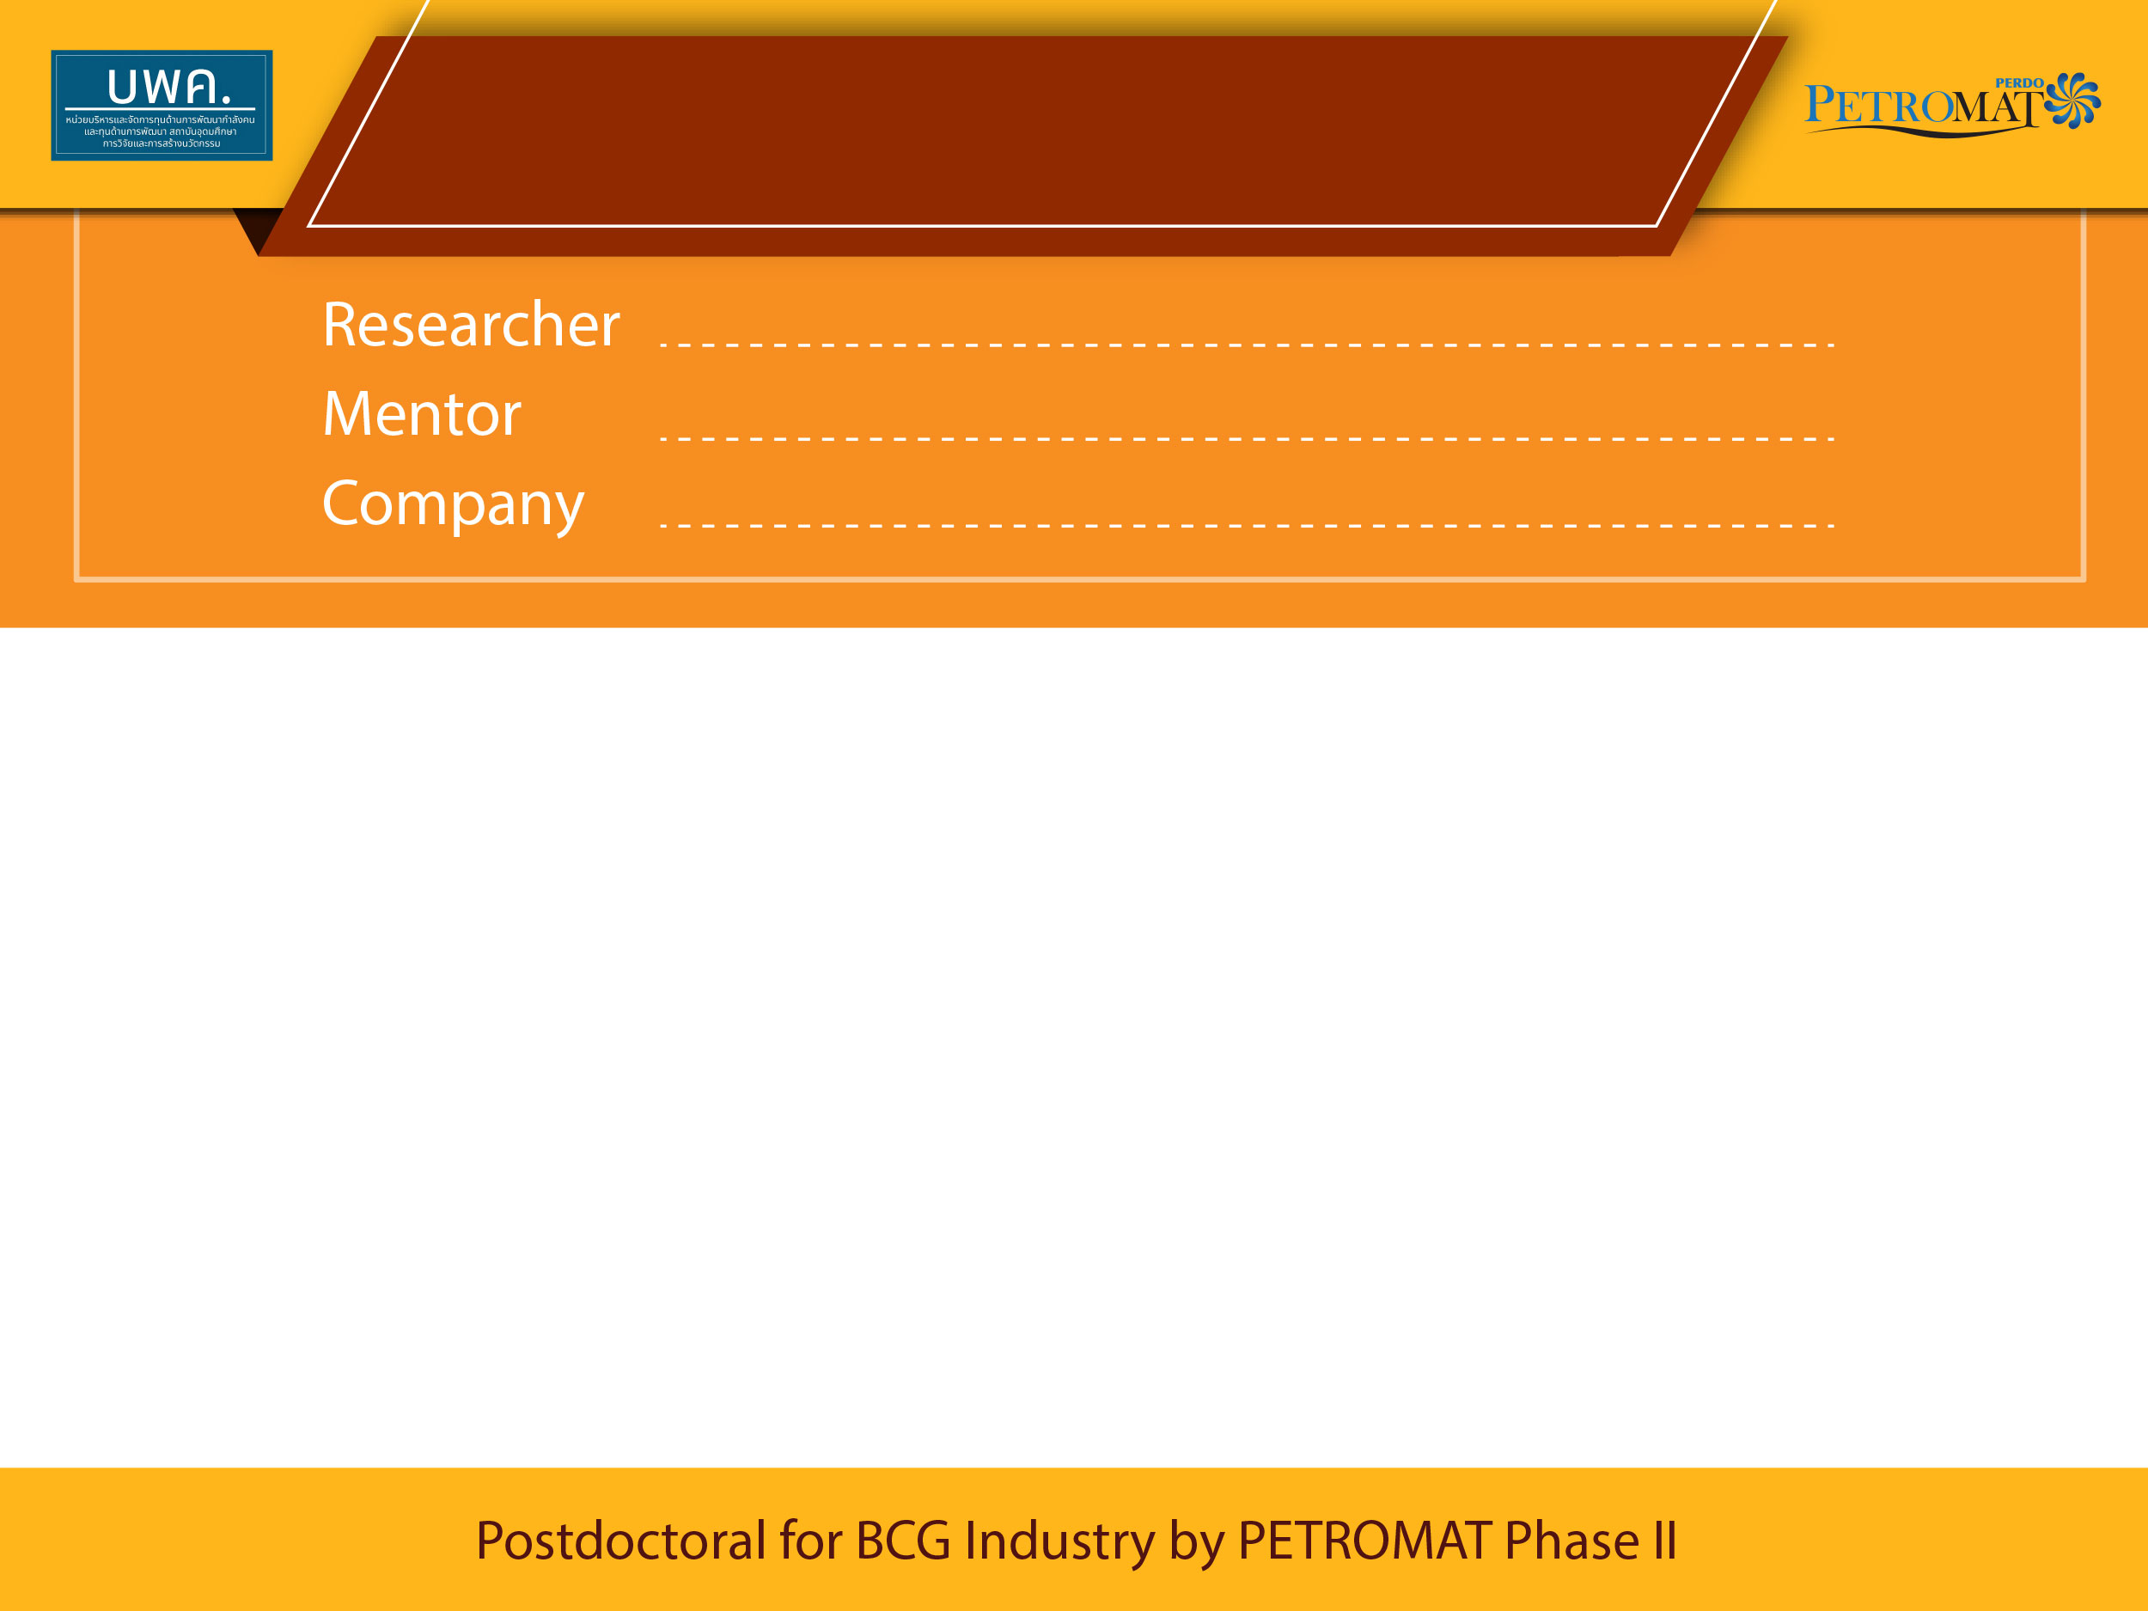
1st PMUB Progress Meeting
Research Topic

Slide 2
Research Motivation

Slide 3
Project Goal

Slide 4
Output / Outcome / Impact

Slide 5
Progress Report

Slide 6
Project Planning

Slide 7
Experience gained

Slide 8
Suggestion
Training Courses
Operating Systems
Etc.

Slide 9


Acknowledgement
Q & A

